Slide 1


PUBLIC SCHOOL RANKING SYSTEM

Slide 2




Kyla Joyce M. Julian
SS152
PROJECT MANAGER
Rhea-Eve M.
Ayungon
SS152
DEVELOPER / QUALITY ASSURANCE ANALYST
Kathrine Danielle C. Burton
SS152
DATABASE ANALYST / DOCUMENTATION LEAD
Joneil Thom O. Llantos
SS152
LEAD DEVELOPER

Slide 3
INTRODUCTION

Slide 4

WHAT IS IT ABOUT
The purpose of the project is to implement two innovative systems that would provide computer-based processes, namely Moodle and OMR, that will help individuals access data, view analytical graphs regarding the educational competency of public schools in the Philippines.
Notes:
After the content --- All of these will be viewable in a dashboard, based on their level of authority.

Slide 5

SCOPE AND LIMITATION
The system will be used by the students, faculty, guidance, principal, district office, division office, and regional office of public schools in order to track students’ and schools’ performance in the field of education.
Notes:
After the content -- However, the system shall not be used to compare and rank data based on the Students’ Quarterly Assessment Exam Results.

Slide 6



PURPOSE OF PROJECT MANAGEMENT
STAY ON TARGET
STAY ON BUDGET
STAY ON
TIME

Slide 7

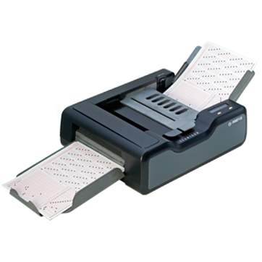
DATA GATHERING
There are two ways to get the data which is the exam results of students. These are the following:
Moodle
OMR Scanner
Notes:
Moodle - The system allows the administration of online tests with a variety of questions. The result of the exam reflects in the database. These will then be imported to the ranking system database. OMR - The flow of the system is the answer sheets shall be collected from the students. It will then go through scanning using an ADF scanner. An OMR processing that records each data will provide result displaying that will be ready for exporting.

Slide 8
GOALS & OBJECTIVES OF THE SYSTEM
GOALS | DESCRIPTION | OBJECTIVES
Administer Moodle based Quarterly Exams | Provide a Moodle system to ease the administering of the exams Provide functions to increase the quality of security of the exam data | To centralize the Quarterly Exams in all regions in the Philippines by implementing a management system called Moodle.
Administer OMR based Quarterly Exams | To produce an accurate data of the exams with minimal error quotient. To efficiently record the results of the exams. Highly reliable with minimize cost | To automate the process by providing speed, reliability, and ease of use against the manual import method.
Manage Data | Extraction of Results Application of analytics to the Quarterly Examination Results | To provide insights from the exam result to the extent of improving the performance of the specific users.
Centralize System | System integration between Ranking System and Moodle System Provide user access level | To optimally manage the users’ data depending on the user access restriction.

Slide 9

ASSUMPTIONS, CONSTRAINTS AND RISKS

Slide 10
ASSUMPTIONS
 | TECHNOLOGY | PEOPLE | PROCESS
Assumption 1 | Ranking System must have an internet access of at least 8.5mbps for them to access the system and use it efficiently | The users must be a computer literate in using the system | The system’s processes must be consistent with the department
Assumption 2 | Ranking System must be equipped with the required hardware requirements | The people who are going to use the system must be authorized personnel in the Department.

Slide 11
RISKS
 | TECHNOLOGY | PEOPLE | PROCESS
Risk 1 | Ranking System must have an internet access of at least 8.5mbps for them to access the system and use it efficiently | The users must be a computer literate in using the system | The system’s processes must be consistent with the department
Risk 2 | Ranking System must be equipped with the required hardware requirements | The people who are going to use the system must be authorized personnel in the Department.

Slide 12
CONSTRAINTS
 | TECHNOLOGY | PEOPLE | PROCESS
Constraint 1 | Ranking System must have an internet access of at least 8.5mbps for them to access the system and use it efficiently | The users must be a computer literate in using the system | The system’s processes must be consistent with the department
Constraint 2 | Ranking System must be equipped with the required hardware requirements | The people who are going to use the system must be authorized personnel in the Department.

Slide 13
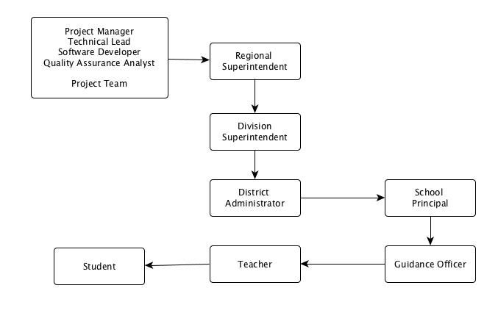
EXTERNAL STRUCTURE

Slide 14

START-UP PLAN

Slide 15
ESTIMATES
WBS | PHASE | TIME ESTIMATION (DAYS) | PARTICIPANTS | ESTIMATED COST
1 | Project Initiation | 10 | Project Manager Technical lead with PHP skills Software Developer Quality Assurance Analyst Documentation Specialist | ₱ 49,268.60
2 | Planning | 14 | Project Manager Technical lead with PHP skills Software Developer Quality Assurance Analyst Documentation Specialist | ₱ 81,361.94
3 | Execution | 72 | Project Manager Technical lead with PHP skills Software Developer Quality Assurance Analyst Documentation Specialist | ₱ 410,390.36
4 | Project Proposal | 4 | Project Manager Technical lead with PHP skills Software Developer Quality Assurance Analyst Documentation Specialist | ₱ 14,788.38

Slide 16





STAFFING
PROJECT MANAGER
No. of Staff: 1
Duration: 67
TECHNICAL LEAD
No. of Staff: 1
Duration: 80
SOFTWARE DEVELOPER
No. of Staff: 1
Duration: 63
QUALITY ASSURANCE ANALYST
No. of Staff: 1
Duration: 32
DOCUMENTATION SPECIALIST
No. of Staff: 1
Duration: 20

Slide 17
PROCUREMENT PLAN:
HUMAN RESOURCE
PROJECT MANAGER
₱256,197.28
TECHNICAL LEAD
₱ 148, 600.00
SOFTWARE DEVELOPER
₱ 88, 855.20
QUALITY ASSURANCE ANALYST
₱45,836.80
DOCUMENTATION SPECIALIST
₱16,256.00

Slide 18





PROCUREMENT PLAN:
DOCUMENTATION
OFFICE 365 BUSINESS
License Purchasing
Internet Speed, Cost, Hardware Availability
₱ 1,875.00
LUCIDCHART
Open Source Online
Cost, Hardware Availability
₱ 1,790.00
GITHUB DESKTOP
Open Source Download
Internet Speed, Hardware Availability
-
EXCEL
Open Source Download
Hardware Availability
-
TESTLINK
Open Source Download
Hardware Availability
-

Slide 19



PROCUREMENT PLAN:
SOFTWARE DEVELOPMENT
XAMPP
Open Source Download
Hardware Availability
-
SUBLIME TEXT
License Purchasing
Cost, Hardware Availability
₱ 4,180.00
GOOGLE CHROME
Open Source Download
Internet Speed, Hardware Availability
-
GITHUB DESKTOP
Open Source Download
Internet Speed, Hardware Availability
-

Slide 20
TYPE | DESCRIPTION | PARTICIPANTS
Project Orientation | The resources and details of the project are introduced and discussed | Project Manager
Development Training | Programming languages such as CodeIgniter are taught to the employees for the developing of the project system | Technical Lead
Quality and Testing Training | The tools and methods of testing the are introduced and discussed for the quality assurance of the project to know what are the needs to be improved | Quality Assurance Analyst
PROJECT STAFFING
TRAINING

Slide 21
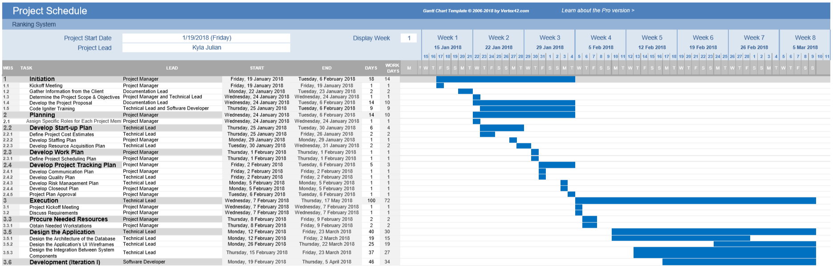
WORK BREAKDOWN STRUCTURE

Slide 22
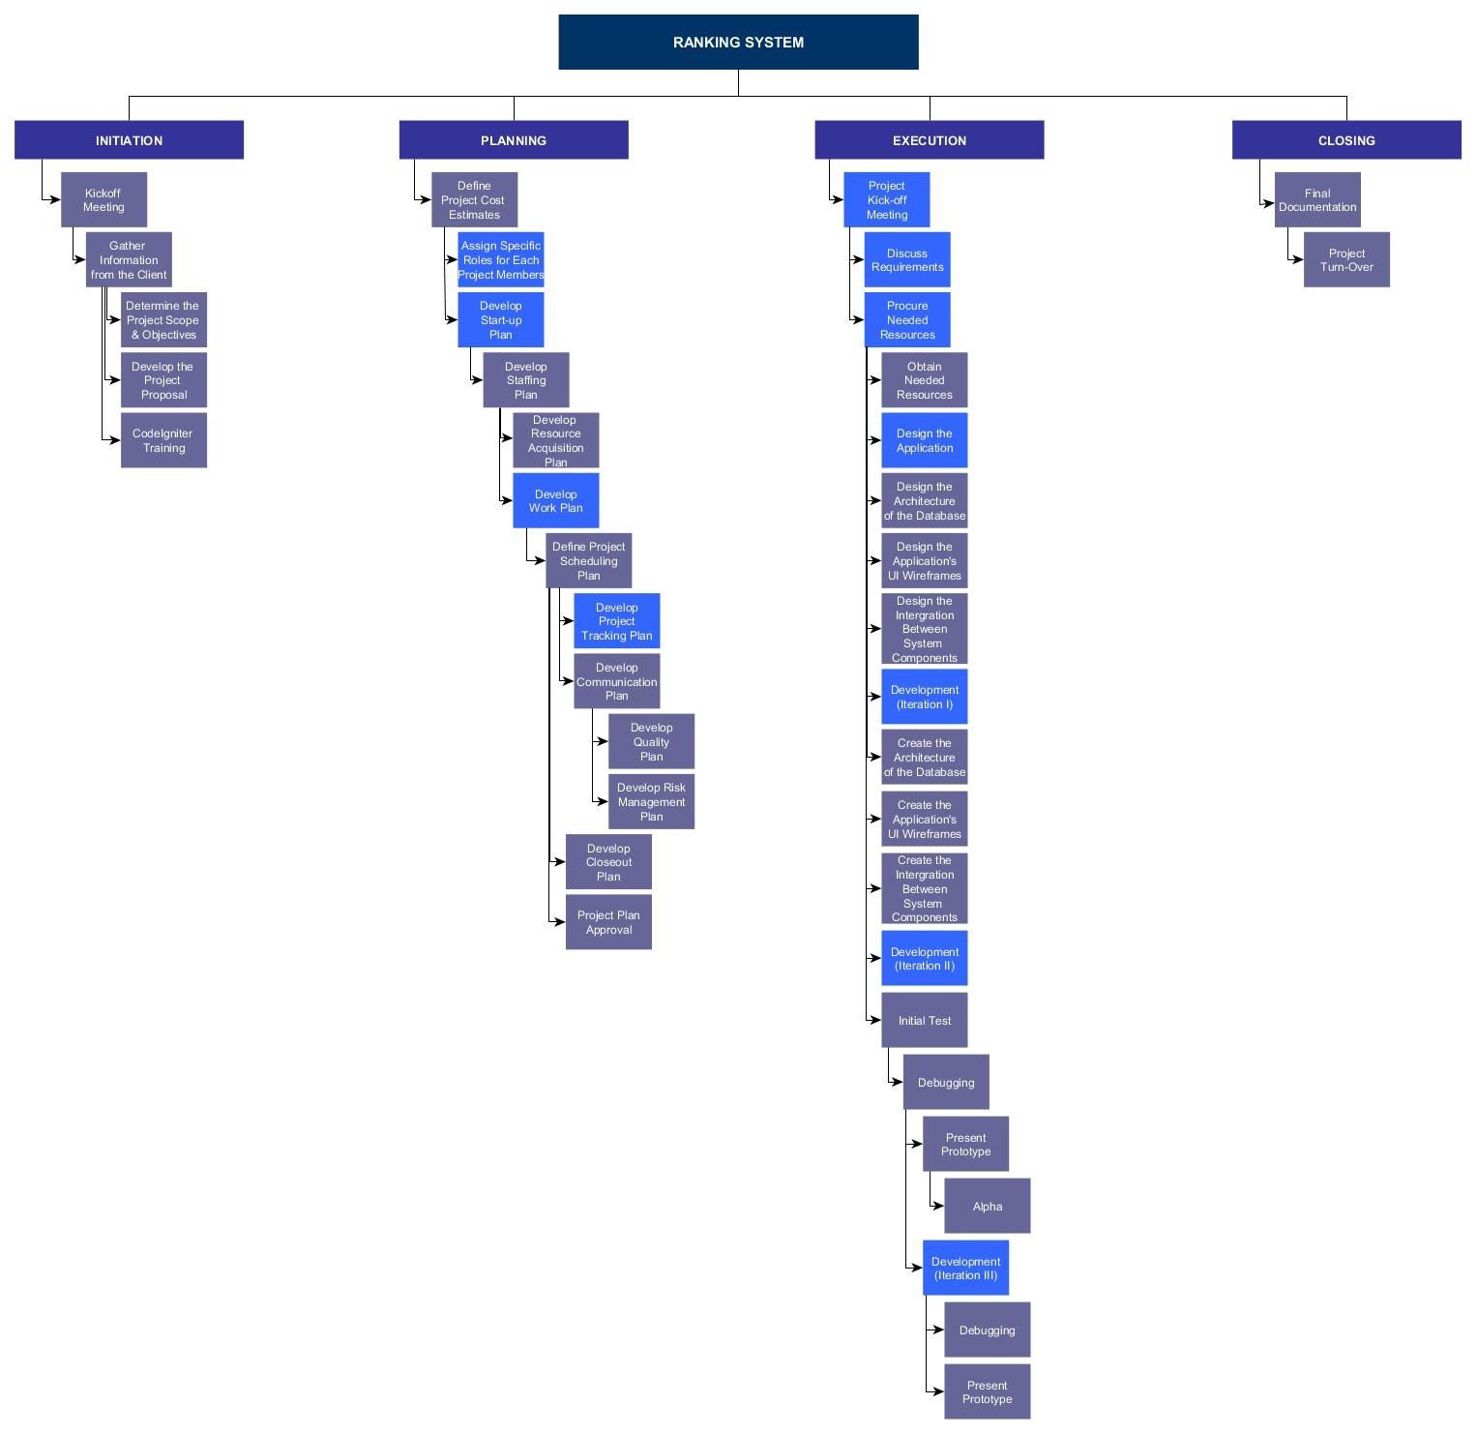
WORK BREAKDOWN STRUCTURE

Slide 23
RESOURCE ALLOCATION
ROLE | START | FINISH | DURATION
Project Manager | January 2018 | May 2018 | 88 days
Technical Lead with PHP skills | January 2018 | May 2018 | 72 days
Software Developer | January 2018 | May 2018 | 63 days
Quality Assurance Manager | January 2018 | May 2018 | 8 days
Documentation Lead | January 2018 | May 2018 | 42 days

Slide 24

BUDGET PLAN

Slide 25





RISK MANAGEMENT PLAN
OVER-BUDGET
CLIENT AVAILABILITY
BEHIND THE SCHEDULE
ABSENCE OR TARDINESS OF THE EMPLOYEES
NEW ADMINISTRATION
Notes:
Overbudget – (desc: spent more than the allotted given budget), (mitigation: make a request for additional funding, diminishing the project’s scope, and reduce cost by having an alternative product.)
Client availability – (desc: availability of the client for meetings didn’t match with the team.), (mitigation: Persuade the client to be committed in this project and have a second person responsible if the schedules still didn’t match.)
Behind the schedule – (desc: deliverables were not submitted on time), (mitigation: Do some overtime or extend the deadline. Another one is to change the scope, and include more resources.)
New administration – (desc: The administration that signed the contract was replaced by a new one and the new administration have another project in mind.) (mitigation: Decrease the planned scope. )
Absence – (desc: The employees were not always present ) (mitigation: Set some rules within the project team or assign multiple task for each employee)

Slide 26

PROCESS MODEL

Slide 27
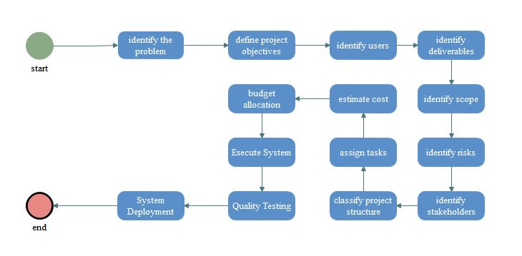
PROCESS MODEL

